Slide 1

Quant Discovery

Slide 2



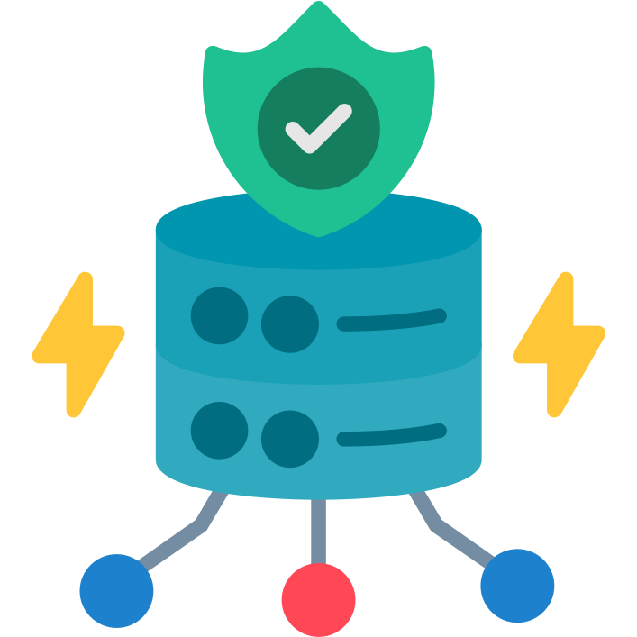








Quant Discovery: Overview
Quant Discovery Namespace
Nginx Router
Sense & QRG Data Source
Oauth2 Proxy
TAASe
Authorization Proxy
QuantEdge & SQLi Data Source
JupyterHub Server
Airflow Scheduler
Trails Data Source
Quant Discovery Resources
Toolchain

Slide 3







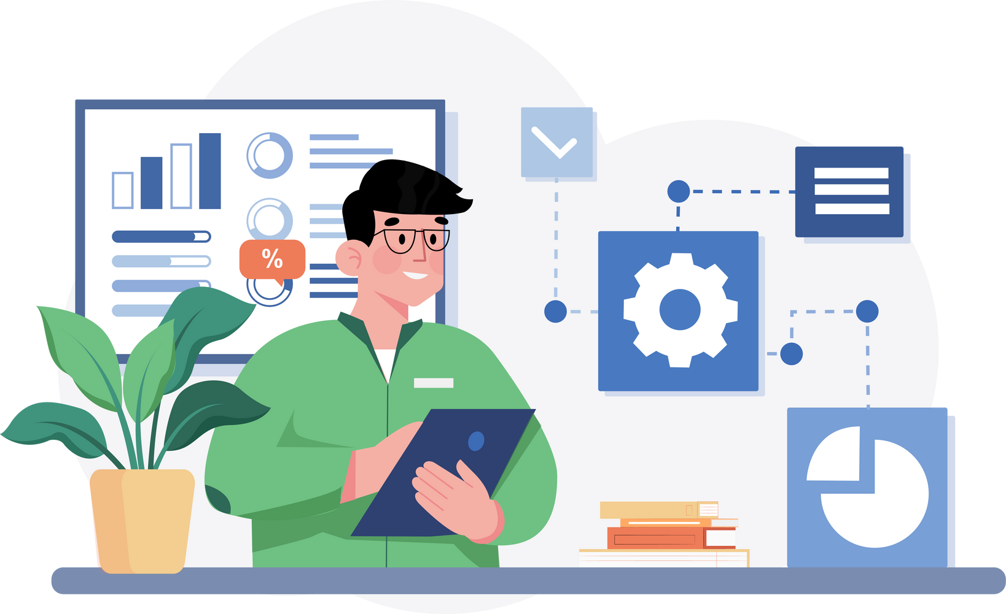
Step 1: Application Registration

